Slide 1
Computed Tomography (CT)
Dr. Rafiqul Islam
CSE Dept, DUET

Slide 2
Introduction
CT Acquisition
A single transmission measurement through the patient made by a single detector at a given moment in time is called ray.
A series of rays that pass through the patient at the same orientation is called projection.

Slide 3
Introduction
Types of Projection
Parallel beam geometry- in which all of the rays in a projection are parallel to each other.
Fan beam geometry – the rays at a given projection angle diverge and have the appearance of a fan.
All modern CT scanners incorporate fan beam geometry in the acquisition and reconstruction process.

Slide 4

Introduction
(a) Parallel beam projection (b) fan beam projection

Slide 5
CT: First Projection

Slide 6
Rotate and Take Another Projection

Slide 7
Rotate and Take Another Projection

Slide 8

This is called a sinogram

Slide 9
This is called a sinogram
Sinogram

Slide 10
This is called a sinogram
Sinogram

Slide 11
This is called a sinogram
Sinogram

Slide 12
This is called a sinogram
Sinogram

Slide 13
This is called a sinogram
Sinogram

Slide 14
This is called a sinogram
Sinogram

Slide 15
This is called a sinogram
Sinogram

Slide 16
This is called a sinogram
Sinogram

Slide 17
This is called a sinogram
Sinogram

Slide 18
This is called a sinogram
Sinogram

Slide 19
This is called a sinogram
Sinogram

Slide 20
This is called a sinogram
Sinogram

Slide 21
This is called a sinogram
Sinogram

Slide 22
This is called a sinogram
Sinogram

Slide 23
This is called a sinogram
Sinogram

Slide 24
This is called a sinogram
Sinogram

Slide 25
This is called a sinogram
The sinogram is what is measured by a CT machine.

Slide 26
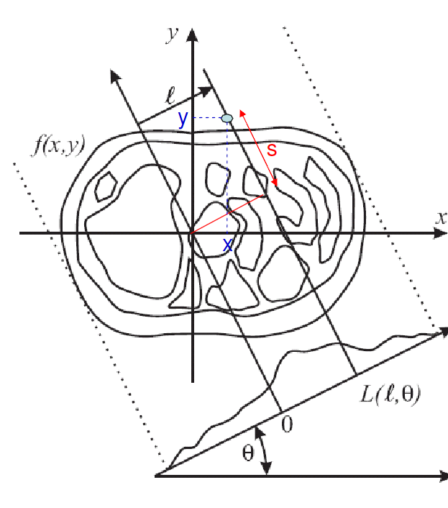
Radon Transform
Given
and
In CT we measure
and need to find
using

Slide 27
Radon Transform
In CT we measure
and need to find
We use

Slide 28
Reconstruction: Back Projection
Step #1: Generate a complete an image for each projection (e.g. for each angle θ)
These are called back projected images
Step #2: Add all the back projected images together

Slide 29
Reconstruction: Back Projection
Original object
Reconstructed object
Kind of worked but we need to do better than this. Need to come up with a better reconstruction algorithm.

Slide 30
Reconstruction: Back projection
Object
A little trick that almost works!

Slide 31
Reconstruction: Back projection
Object
We do this for every angle and then add together all the back projected images

Slide 32
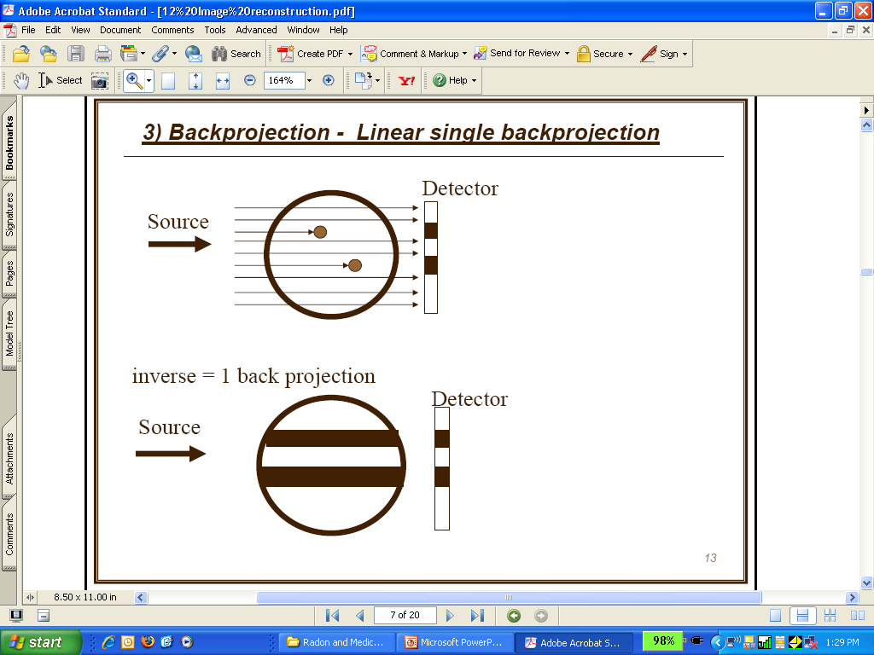
Reconstruction: Back projection
We know that objects are somewhere here in black stripes, but where?

Slide 33
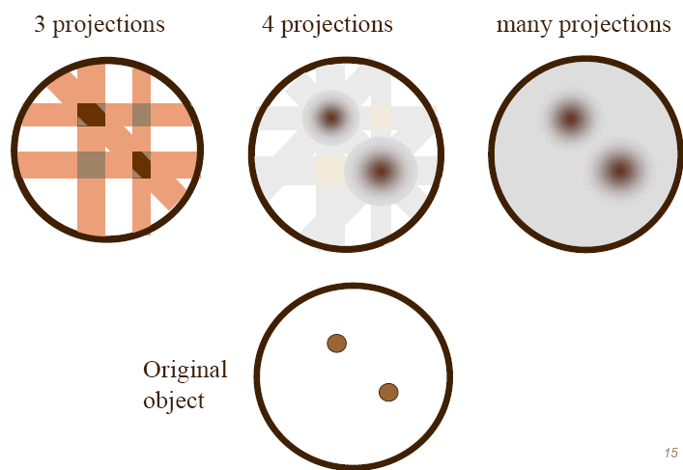
Reconstruction: Back projection

Slide 34
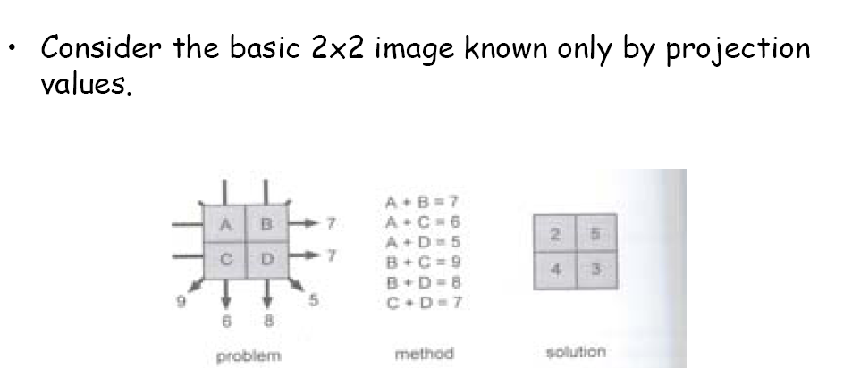
Reconstruction: Back projection
Given are sums, we have to reconstruct values of pixels A, B, C and D

Slide 35
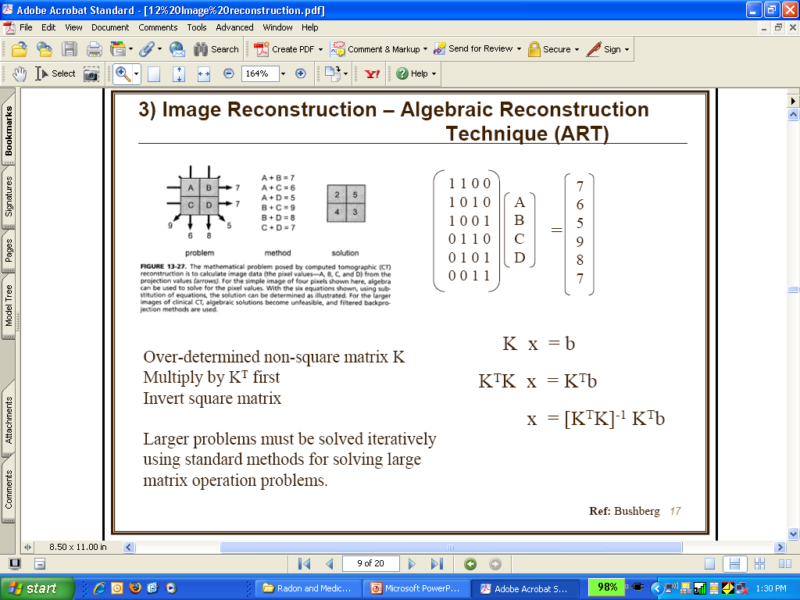
Reconstruction: ART

Slide 36
Reconstruction: ART
METHOD: Algebraic Reconstruction Technique
iterative technique
attributed to Gordon
Initial Guess
Reconstructed model
Back- Projection
Projection
Actual Data Slices
Notes:
36

Slide 37
Reconstruction: Filtered Back Projection
METHOD: Filtered Back Projection
common method
uses Radon transform and Fourier Slice Theorem
y
F(u,v)
f(x,y)
G_{φ}(ρ)
x
s
u
g_{φ}(s)
φ
Spatial Domain
Frequency Domain

Slide 38
Reconstruction: Filtered Back Projection
This always works!
Object
Digital Filter
take 1D FFT of projection
multiply by ramp filter
take 1D inverse FFT
make a back projection

Slide 39
Reconstruction: Filtered Back Projection
Always works!
Object
Digital Filter
take 1D FFT of projection
multiply by ramp filter
take 1D inverse FFT
make a back projection

Slide 40
Reconstruction: Filtered Back Projection
Always works!
Object
Digital Filter
take 1D FFT of projection
multiply by ramp filter
take 1D inverse FFT
make a back projection
We do this for every angle and then add together all the filtered back projected images

Slide 41
Comparison: ART Vs FBP
ART
FBP
Algebraic Reconstruction Technique
Still slow
better quality for fewer projections
better quality for non-uniform project.
“guided” reconstruct. (initial guess!)
Filtered Back Projection
Computationally cheap
Clinically usually 500 projections per slice
problematic for noisy projections
Notes:
41

Slide 42
CT Reconstruction: Matlab
Radon Transform and a Head Phantom

Slide 43
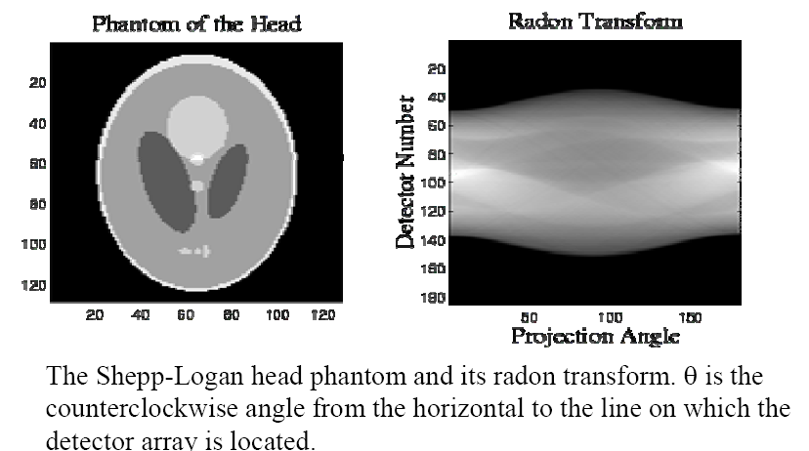
CT Reconstruction: Matlab

Slide 44
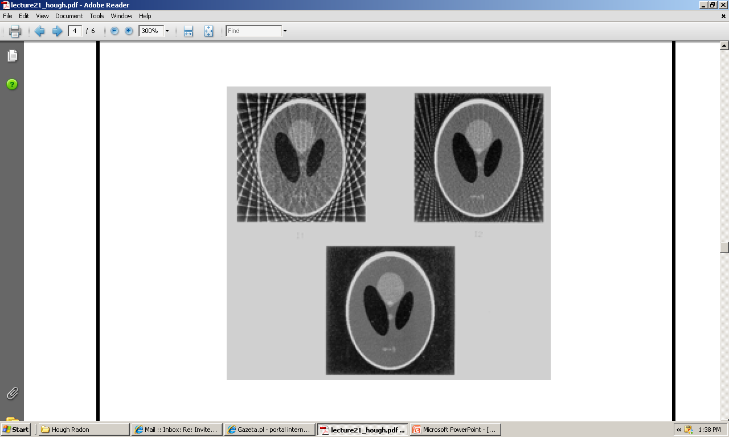
CT Reconstruction: Matlab
Reconstructing with more and more rays

Slide 45
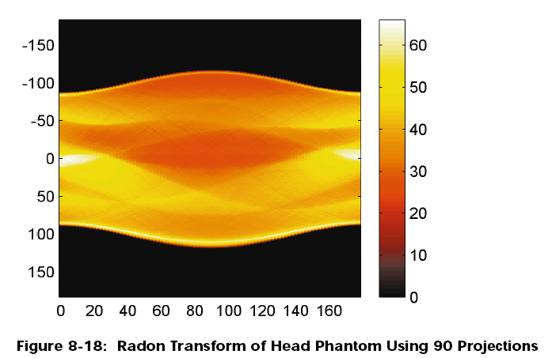
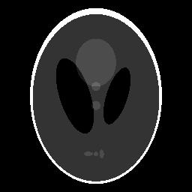
CT Reconstruction: Matlab
[Y-axis] distance, [X-axis] angle
(From Matlab Image Processing Toolbox Documentation)

Slide 46
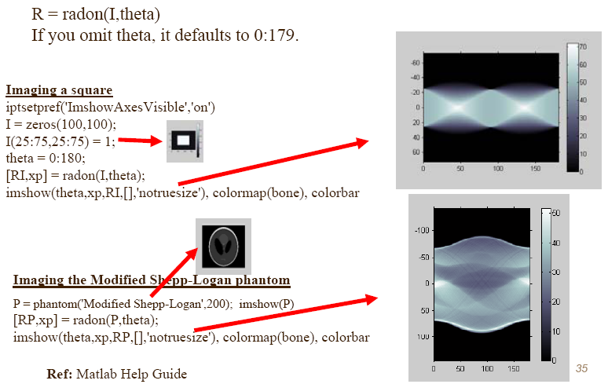
CT Reconstruction: Matlab

Slide 47
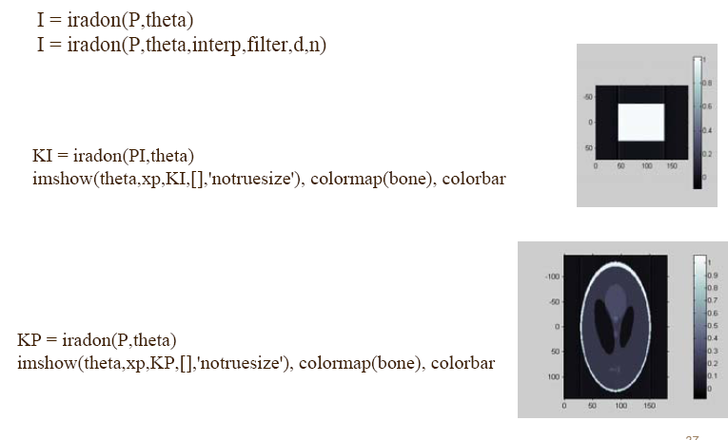
CT Reconstruction: Matlab

Slide 48
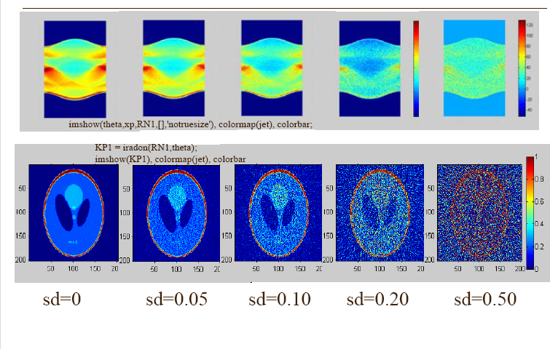
CT Reconstruction: Matlab
No noise
big noise

Slide 49
Thank you
Questions?

